Slide 1
ECE 551 Digital System Design & Synthesis
Synthesis

Slide 2
Administrative Matters
Midterm is Thursday March 10th in Psychology 113
Synthesis tutorial March 14th, 15th & 16th
Monday 6:00 – 7:00 room B555
Tuesday 6:00 – 7:00 room B555
Wednesday 6:00 – 7:00 room B555
HW3 Due Friday March 3rd @ Class
Team Formation (teams of 3-4)
Start arranging your teams

Slide 3
Synthesis Priorities
First there is functionality
Is function coded in Verilog same as synthesized netlist?
Boolean correct
Sequential correct
No uninteded latches or strange clock gating
Next there are design rules
Is the fanout reasonable.
Are my transition times fast enough (Hot Electron)
Finally there are performance criteria
Speed
Power
Area

Slide 4
Synthesis is cost function driven
Cost is a function of:
Timing
Area
Power
Cost(mapping) = -Slack(mapping) +
Area(mapping) +
[power(mapping)]
In this priority order
Explore mapping space to minimize
this function (not the exact function)
Mapping refers to the mapping of the logic (elaborated database) to the cell library
Synopsys is a bit like the typical ECE Student…Smart, but a touch lazy
Loose Constraints ➔ Loose Design

Slide 5
What Needs Constraint?
clk
input delay
input to D
delays
cycle time
Q to output
delays
output delay
primary
inputs
primary
outputs
Combinational
Combinational
Combinational
clk

Slide 6
Setting Basic Timing Constraints
Establishing clock period, waveform, and pin it is sourced to:
create_clock -name "clk" -period 20 -waveform { 0 10 } clk
rise @ 0ns
fall @ 10ns
Name of clock, (a handle) not the pin it is sourced to
Pin this clock is sourced to
period = 20ns
Clock is no ordinary input. Can’t let Synopsys buffer it and do other silly such things.
If clock distribution requires buffering then that will be done by a separate tool (CTS) inside the APR environment.

Slide 7
Defining Input Delay
clk
input delay
τ – input_delay
DUT
Combinational
Combinational
source
of input
to DUT
clk
clk
input delay is specified as time after the clock edge (of prior clock cycle)
that the input to the DUT is valid.

Slide 8
Defining Output Delay
clk
τ – output_delay
output delay
DUT
Combinational
Combinational
clk
clk
output delay is specified as time prior to next rising edge that the output has to be valid.

Slide 9
What Else Needs Constraint?
in
in
in
out
out
out
t_{PHL}
t_{PHL}
Propagation delay of a gate is not constant
There is a term that depends on input slope
Synthesis knows the capacitance of a primary input
Synthesis does not know the drive strength of a primary input
We must inform Synopsys about the drive strength of the inputs
set_driving_cell -lib_cell <cell> -pin Z -library <lib> <list_of_inputs>
set_drive <# of ohms> <signal>

Slide 10
What Else Needs Constraint?
in
in
in
out
in
out
out
out
Small
load
Big
load
t_{PHL}
t_{PHL}
Capacitive loading affects the propagation delay of a gate
For a given drive strength the slope of the output will elongate with increased capacitive load
Synopsys needs to know the capacitive load of primary outputs so it can size gates (or buffer up) to drive load with “crisp” transition times.
We must inform Synopsys about the load on primary outputs
set_load <capacitance> <list of outputs>

Slide 11
Anything More Need Constraints?
in
parasitic
??pF
What is the parasitic capacitance of this node?
gate capacitance is known by Synopsys
routing capacitance is the unknown
how to estimate?
fanout
size of design (gate count)
set_wire_load_model -name <m_name> -library <lib_name>

Slide 12
Are We Done Yet…Not Quite
2.0V
2.0V
I_{DS}
V_{GS}=2.0
V_{GS}=1.5
n+
n+
p-substrate
V_{GS}=1.0
V_{DS}
When both V_{DS} and V_{GS} are high a transistor is conducting heavily.
Electrons “flying” across the channel get a lot of kinetic energy.
These electrons are also attracted to the surface by the high gate potential.
They can embed themselves in the gate oxide (causes V_{T} degradation).
This is called “Hot Electron Effect”
Need to limit operating time at high V_{DS} & V_{GS}. Need “snappy” transitions.
set_max_transition_time <time> [current_design]

Slide 13
GUI’s are for Children
GUI’s are for learning and some instances of debugging.
Once you know the tool you will mainly work in shell mode (at least that is my preference):
unix_prompt>design_vision –shell dc_shell

Slide 14
Sample DC Shell Script [1]
read_file -format verilog {./source/ss_a2d_dp.v}
###########################
# Define clock and set don't mess with it #
##########################
create_clock -name "clk" -period 20 -waveform { 0 10 } { clk }
set_dont_touch_network [find port clk]
# setup pointer that contains all inputs except clock #
set prim_inputs [remove_from_collection [all_inputs] [find port clk]]
#########################
# Set input delay & drive on all inputs #
########################
set_input_delay -clock clk 5 [copy_collection $prim_inputs]
set_driving_cell -lib_cell AO33D0BWP -pin Z -from_pin A1 -library \
tcbn40lpbwptc [copy_collection $prim_inputs]
# tell it por_n strongly driven so it won't buffer
set_drive 0.1 por_n

Slide 15
Sample DC Shell Script [2]
##########################
# Set output delay & load on all outputs #
##########################
set_output_delay -clock clk 5 [all_outputs]
set_load 0.10 [all_outputs]
#####################################
# Wire load model allows it to estimate internal parasitics #
####################################
set_wire_load_model -name TSMC32K_Lowk_Conservative \
-library tcbn40lpbwptc
##################################
# Max transition time is important for Hot-E reasons #
#################################
set_max_transition 0.10 [current_design]
#########################
# Now actually synthesize for 1st time #
#########################
compile -map_effort low

Slide 16
Sample DC Shell Script [3]
check_design
## design ware component caused extra pins
report_area
########################
# Take a look at max & min timings #
#######################
report_timing -path full -delay max -nworst 3
report_timing -path full -delay min -nworst 3
## smash the hierarchy (design ware component)
ungroup -all
compile -map_effort medium
check_design
report_area
#### write out final netlist ######
write –format verilog ss_a2d_dp –output ss_a2d_dp.vg
Now lets run this line by line and
see what it does

Slide 17
Some “Nice to Have” Constraints
set_max_area 20000
Sets maximum area to 20,000 area units (square microns)
set_max_dynamic_power 10
Sets maximum dynamic power to 10 mW (default unit for our library is mW)
Note: Power & Speed often work against each other.
A tight timing constrained design will use more parallel hardware.
More nodes toggling, results computed and then discarded
Note: Area & Power often work together.
In general less area => less toggling nodes
less net capacitance switching

Slide 18
Timing Reports….How do I read these?
dc_shell-xg-t> report_timing -delay max –nworst 1
****************************************
Report : timing
-path full
-delay max
-max_paths 1
Design : ss_a2d_dp
Version: Y-2006.06-SP1
Date : Thu Oct 2 09:00:42 2008
****************************************
Operating Conditions: NOM Library: gflxp
Wire Load Model Mode: enclosed
Startpoint: DAC_reg[0] (rising edge-triggered flip-flop clocked by clk)
Endpoint: DAC_full (output port clocked by clk)
Path Group: clk
Path Type: max
report the worst timing path for max delay scenario
Startpoint <signal> <type>
Endpoint <signal> <type>
Very useful to look at
Report continued next page

Slide 19
Timing Reports….How do I read these?
Point Incr Path
-----------------------------------------------------------
clock clk (rise edge) 0.00 0.00
clock network delay (ideal) 0.00 0.00
DAC_reg[0]/CP (FD2LQM3P) 0.00 0.00 r
DAC_reg[0]/Q (FD2LQM3P) 0.25 0.25 r
U59/Z (AND3M1P) 0.10 0.35 r
U55/Z (ND4M2P) 0.13 0.48 f
U56/Z (NR3M6P) 0.21 0.69 r
DAC_full (out) 0.00 0.69 r
data arrival time 0.69
clock clk (rise edge) 20.00 20.00
clock network delay (ideal) 0.00 20.00
output external delay -5.00 15.00
data required time 15.00
-----------------------------------------------------------
data required time 15.00
data arrival time -0.69
-----------------------------------------------------------
slack (MET) 14.31
+ slack is a good thing, it means met timing

Slide 20
Timing Report…min delay
dc_shell-xg-t> report_timing -delay min -nworst 1
Information: Updating design information... (UID-85)
****************************************
Report : timing
-path full
-delay min
-max_paths 1
Design : ss_a2d_dp
Version: Y-2006.06-SP1
Date : Thu Oct 2 09:17:50 2008
****************************************
Operating Conditions: NOM Library: gflxp
Wire Load Model Mode: enclosed
Startpoint: accum_reg_reg[0]
(rising edge-triggered flip-flop clocked by clk)
Endpoint: accum_reg_reg[0]
(rising edge-triggered flip-flop clocked by clk)
Use keywork min to get this report
Surprise, Surprise, the min delay is a path between two flops
Report continued next page

Slide 21
Timing Report…min delay
Point Incr Path
-----------------------------------------------------------
clock clk (rise edge) 0.00 0.00
clock network delay (ideal) 0.00 0.00
accum_reg_reg[0]/CP (FD2LQM1P) 0.00 0.00 r
accum_reg_reg[0]/Q (FD2LQM1P) 0.11 0.11 f
U67/Z (EOFM1P) 0.05 0.16 r
accum_reg_reg[0]/D (FD2LQM1P) 0.00 0.16 r
data arrival time 0.16
clock clk (rise edge) 0.00 0.00
clock network delay (ideal) 0.00 0.00
accum_reg_reg[0]/CP (FD2LQM1P) 0.00 0.00 r
library hold time 0.08 0.08
data required time 0.08
-----------------------------------------------------------
data required time 0.08
data arrival time -0.16
-----------------------------------------------------------
slack (MET) 0.09
Oh good, we made it

Slide 22
Hold time (worst case is back to back FF’s)
Hold time slack for back to back flop
scenario with our library
Slack = Clk2q – Hold = +0.03ns
We are “golden” we don’t even have to
worry about this…right?
T_{clk2q}=0.11ns
T_{hold}=0.08ns
clk
1
clk
2
Any large design will require a clock tree to distribute the clock.
Clock is a large capacitive load. Can’t just drive with one honking driver (RC of wires will kill you then)
Now you have clock skew
clk_root
set_clock_uncertainty 0.15 clk
Inform Synopsys about your skew

Slide 23
Hold Time…how do we fix?
T_{clk2q}=0.11ns
T_{hold}=0.08ns
Slack = Clk2q – Hold – Uncertainty = -0.12ns
-.05
+.10
CTS did the best it could already
clk
1
clk
2
Have to add a buffer to slow the
signal down
Referred to as a: min-delay buffer
clk_root

Slide 24
Lets Play…fire up design_vision
Code a 64 bit accumulator
read_file –format verilog accum.v
constrain the clock to 2ns and compile
report_area ➔ why are there only 2 combinational cells??
check_design ➔ why are there all these dangling nets?
write –format verilog accum –output accum.vg
ungroup –all –flatten ➔ compile again
report_area again
report_timing –delay max
now constrain clock to 1.5ns and compile again…what did area do
report_timing –delay min
set_clock_uncertainty 0.2 clk
report_timing –delay min ➔ compile agian
report_timing –delay min ➔ Why are there still violators
set_fix_hold clk
compile again

Slide 25
“Holy Mackerel Batmat, This thing is a monster”
Synopsys is 1 of only 2 significant players in the EDA world
Any startup with an interesting EDA tool gets “assimulated”
Their EDA tool offering is vast (many good tools)
We are only interested in Design Vision/Design Compiler
Design Compiler is their oldest most used tool (around in one form or another since 1986)
28 years of development makes for a monster of a CAD tool

Slide 26
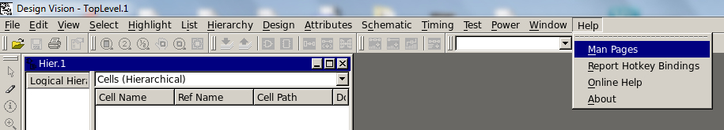
Help!
If you kick off design_vision in GUI mode it has a help➔Man Pages in the banner menu
Under this you will find the full list of commands
Yaaa … real fine Hoffman, this only does me good if I know what command I am looking for.

Slide 27
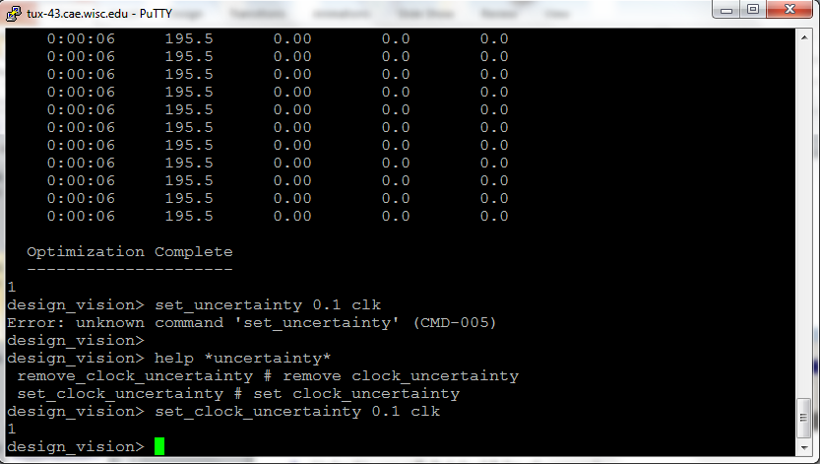
Help!
Couldn’t remember command name, but knew it
had something to do with uncertainty. Can use wildcard matching with help to get a list of applicable commands.
Once you know the command you can get specific help
design_vision>set_clock_uncertainty -help

Slide 28
Optimization Priorities
Design rules have priority over timing goals
Timing goals have priority over area goals
Max delay has priority over min-delay
To prioritize area constraints:
use the ignore_tns (total negative slack) option when you specify the area constraint:
set_max_area -ignore_tns 10000
To change priorities use set_cost_priority
Example: set_cost_priority -delay
Specifies that area is to be prioritized above TNS
prioritizing delay over max transition rules

Slide 29
Constraints Default Cost Vector

Slide 30
Compiling the Design
Useful compile options include:
-map_effort low | medium | high (default is medium)
-area_effort low | medium | high (default same as map_effort)
-incremental_mapping (may improve already-mapped)
-verify (compares initial and synthesized designs)
-ungroup_all (collapses all levels of design hierarchy)
New compile_ultra command
Two pass high effort compile of the design
May want to compile normally first to get ballpark figure (higher effort == longer compilation)

Slide 31
Top-Down Compilation
Use top-down compile strategy for medium to small designs
Basic steps are:
Read in the entire design
Resolve multiple instances of any design references with uniquify
Apply attributes and constraints to the top level
Compile the design using compile or compile_ultra

Slide 32
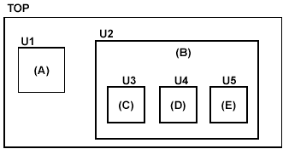
Example Top-Down Script
# read in the entire design
read_file -library WORK -format verilog {E.v D.v C.v B.v A.v TOP.v}
current_design TOP
# link TOP.v to libraries and modules it references
Link
# set design constraints
…
set_max_area 2000
# resolve multiple references
uniquify
# compile the design
compile –area_effort high
What??
Will cover this a bit later

Slide 33
Bottom-Up Compile Strategy
The bottom-up compile strategy
Compile the subdesigns separately and then incorporate them
Top-level constraints are applied and the design is checked for violations.
Advantages:
Compiles large designs more quickly (divide-and-conquer)
Requires less memory than top-down compile
Disadvantages
Need to develop local constraints as well as global constraints
May need to repeat process several times to meet design goals
Only likely to use if running into serious memory or performance issues
This is a royal pain in the butt

Slide 34
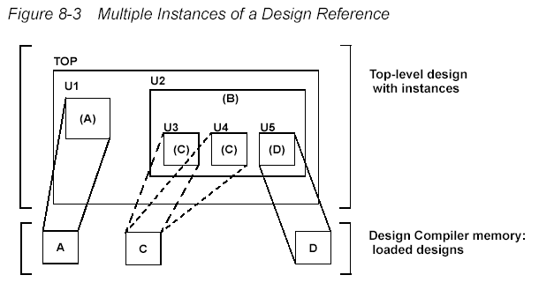
Resolving Multiple References
In a hierarchical design, subdesigns are often referenced by more than one cell instance

Slide 35
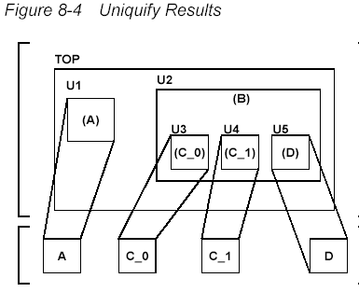
Uniquify Method
The uniquify command creates a uniquely named copy of the design for each instance.
current_design top
uniquify
compile
Each design optimized separately
What are advantages and disadvantages?

Slide 36
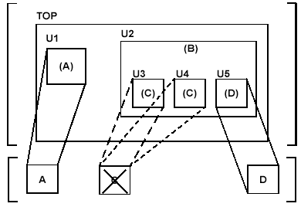
Compile-once-don’t-touch Method
The compile-once-don’t-touch method uses the set_dont_touch command to preserve the compiled subdesign
current_design top
characterize –constraints U2/U3
current_design C
compile
current_design top
set_dont_touch {U2/U3 U2/U4}
compile
What are advantages and disadvantages?

Slide 37
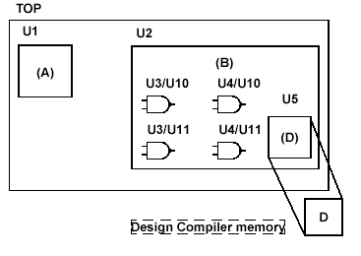
Ungroup Method
The ungroup command makes unique copies of the design and removes levels of the hierarchy
current_design B
ungroup {U3 U4}
current_design top
compile
What are advantages and disadvantages?

Slide 38
Flattening Hierarchy
module logic1(input a, c, e, output reg x);
always @(a, c, e)
x = ((~a|~c) & e) | (a&c);
endmodule
module logic2(input a, b, c, d, output reg y);
always @(a, b, c, d)
y = ((((~a|~c)&b) | ((a|~b)&c))&d) | ((a|~b)&~d);
endmodule
module logic(input a, b, c, d, e, f, output reg z);
wire x, y;
logic1(a, c, e, x);
logic2(a, b, c, d, y);
always @(x, y, f)
z = (~f&x) | (f&y);
endmodule
Unflattened Hierarchy
Area: 36.15
Delay: 0.25
Flattened Hierarchy
Area: 34.15
Delay: 0.25

Slide 39
Checking your Design
Use the check_design command to verify design consistency.
Usually run both before and after compiling a design
Gives a list of warning and error messages
Errors will cause compiles to fail
Warnings indicate a problem with the current design
Try to fix all of these, since later they can lead to problems
Use check_design –summary or check_design -no_warnings to limit the number of warnings given
Use check_timing to locate potential timing problems
Use report_contraints –all_violators (check everything)

Slide 40
Analyzing your Design [1]
There are several commands to analyze your design
report_design
display characteristics of the current design
operating conditions, wire load model, output delays, etc.
parameters used by the design
report_area
displays area information for the current design
number of nets, ports, cells, references
area of combinational logic, non-combinational, interconnect, total

Slide 41
Analyzing your Design [2]
report_hierarchy
displays the reference hierarchy of the current design
tells modules/cells used and the libraries they come from
report_timing
reports timing information about the design
default shows one worst case delay path
report_resources
Lists the resources and datapath blocks used by the current design
Can send reports to files
report_resources > cmult_resources.rpt
Lots of other report commands available

Slide 42
Optimization Strategies
Area vs. Delay - Often only really optimize for one
“Fastest given an area constraint”
“Smallest given a speed constraint”
Design Compiler Reference Manual has several pointers on synthesis settings for these goals

